Slide 1
The Final Software Project
Carmelo Gonzalez The University of Arizona Global Campus CST 499: Capstone for Computer Software Technology Joseph Rangitsch May 13, 2024

Slide 2
Online Course Enrollment System

Slide 3
Agenda
Introduction
SRS Document
UML Design Model
Landing, Login, and Enrollment Pages
MySQL Database and Class Registration
PHP Code

Slide 4

Online Course Enrollment System
The project is focused on helping students enroll in courses online. The website was constructed using XAMPP and Eclipse as the integrated development environment (IDE).

Slide 5

Software requirement Document
Requirements of the project
New user registration that includes name, phone, email, and password
Using a unique ID (email address)
Separate courses in semesters
Courses will have a maximum amount of enrollment
The waiting list is used for courses over the maximum enrollment
Be able to withdraw from registration and waiting list

Slide 6
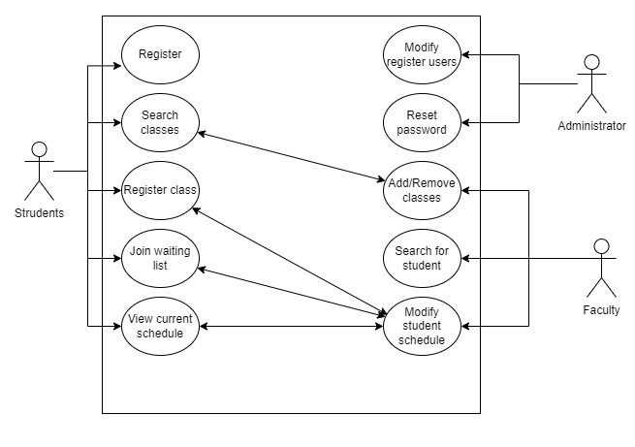
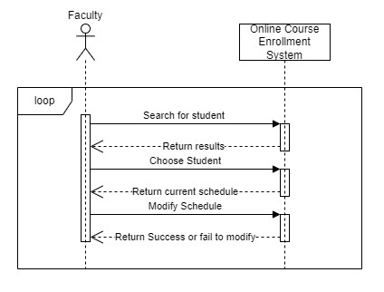
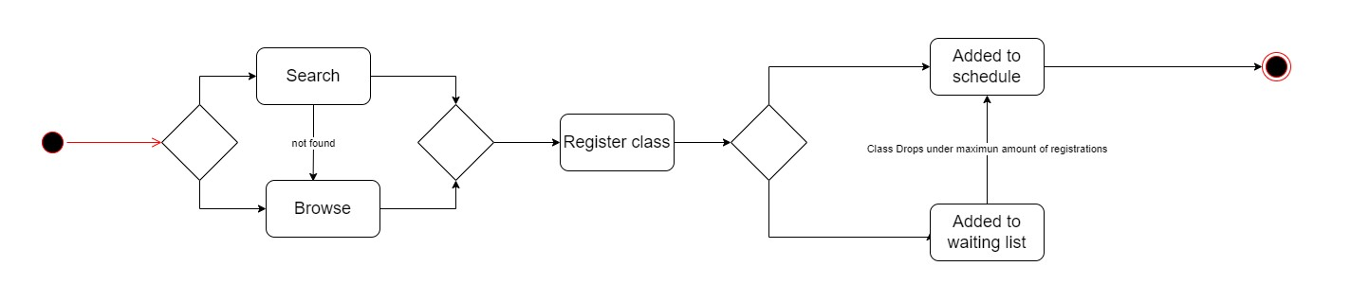
UML Design Model

Slide 7
Landing, Login, and Enrollment Pages
Simple design with the Bootstrap Cascading Style Sheets (CSS) framework
The registration page lets a user create an account
The login page enables a register to user login and access course registration
The main menu page allows a user to choose between adding courses, viewing currently registered courses, or viewing courses with a waiting list
Users can register and unregister from a course or a waiting list

Slide 8
MySQL Database and Class Registration
MySQL Database:
Tbluser – hold all user data
Tblsemester and Tblcourse hold course and semester data
Tblcoursesemester hold data on available courses per semester, teacher name, and maximum enrollment
Tblstudenthistory hold registered classes by student
Tblswaitinglist hold class waiting list and position in the waiting for the student
Class registration:
Classes are organized by semester
When a user select a class the system
Check if the student is already register
Check if the class has reach maximum enrollment
The confirmation lets you know if you are enrolled or in a waiting list

Slide 9
Personal Home Page Code
Classes
DBconn – connects to MySQL database and executes all SQL statements generated by other classes.
New user – check for unique email and insert data to the user table.
User Service – checks login info and passes session data once login.
Course – retrieve courses by semester, check maximum enrollment, and determine if the user enrolled on a course or waiting list
Session control – check for session id to allow to pages that required a login user.
PHP Pages:
Index.php – main page
Registration.php – page for the user to register and create a password
Login.php – the page that checks email and password against the database, and if it finds a match, it redirects to mainmenu.php with a session number
Mainmenu.php – page with the options to register a course, view register courses, or view the waiting list
Addcourse.php - page used to register a course or be added to the waiting list
Viewcourse.php – page for the user to see register courses
Viewwl.php – page for the user to see the waiting list
Courses.php, dbconn.php, newuser.php, sessioncontrol.php, userservice.php – classes used by the other php pages

Slide 10
Reference
Connolly, R., & Hoar, R. (2018). Fundamentals of web development (2nd ed.). Pearson.
Tsui, F., Karam, O., & Bernal, B. (2018). Essentials of software engineering (4th ed.). Jones & Bartlett Learning.

Slide 11
Thank you
Carmelo Gonzalez
carmelo.gonzalez2@student.uagc.edu

